Slide 1
MEEG 3379 Elements of Mechanical Design
Dr. Shweta Dabetwar
(office hours: Every Thursday 12.15-1.15 pm EIT 544)
sdabetwar@ualr.edu
TA: Colby Martinez
(cjmartinez@ualr.edu)

Slide 2
Ch 5: Failures resulting from static loading
Reference Textbook
Shigley's Mechanical Engineering Design
By Richard Budynas
Edition: 11TH
Publisher: McGraw Hill
ISBN: 978-981-315-898-6

Slide 3
Concept of failure
What is failure?
When a component or a system of components cannot do its’ intended job.
-Part separating into pieces
-permanent distortion
-downgraded reliability
-compromised function
Why do systems or components fail? What are some of the reasons?
Diminished strength!

Slide 4
Why does failure happen?
All the manufacturing parts go through extensive testing, so why?
Strengths of all mass-produced parts will be different due to the variation of dimension, machining, forming, and composition
Strength is statistical in nature with a mean, standard deviations, and distributional identification
Cannot use published values of yield or ultimate strength.
Testing is very important to duplicate the actual design situation!
Stress concentration during operation can throw everything off!

Slide 5
Four design categories
Failure of the part would endanger human life or the part is made in extremely large quantities, consequently, an elaborate testing program is justified during the design
The part is made in large enough quantities that a moderate series of tests is feasible
The part is made in such small quantities that testing is not justified at all, or the design must be completed so rapidly that there is not enough time for testing
The part has already been designed, manufactured, and tested; and found to be unsatisfactory. Analysis is required to understand why and how to improve it.

Slide 6
Discussion
1) if you are hired at a startup with limited resources and less testing facilities, but your product needs very high accuracy, what measures would you take?
2) you are design engineer working in each of the four design categories, what measures would you take?

Slide 7
Static load
A static load is a stationary force or couple applied to a member.
To be stationary, the force or couple must not change in:
Magnitude
Direction
Point/s of application
A static load can produce:
Axial tension or compression
Shear load
Bending load
Torsional load
Combination of two or more loads

Slide 8
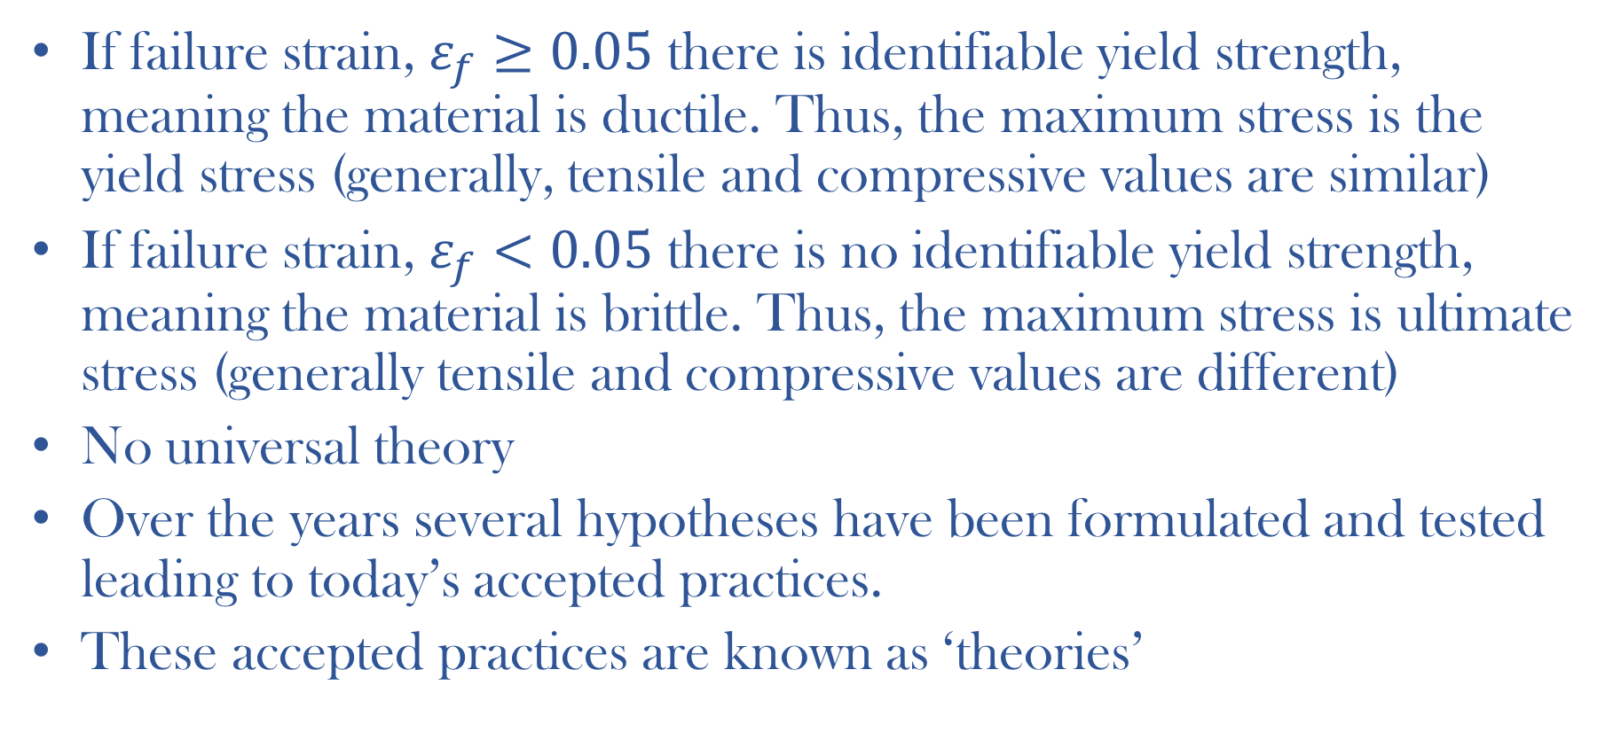
Background of failure theories
If failure strain, $ε_{f}≥0.05$ there is identifiable yield strength, meaning the material is ductile. Thus, the maximum stress is the yield stress (generally, tensile and compressive values are similar)
If failure strain, $ε_{f}<0.05$ there is no identifiable yield strength, meaning the material is brittle. Thus, the maximum stress is ultimate stress (generally tensile and compressive values are different)
No universal theory
Over the years several hypotheses have been formulated and tested leading to today’s accepted practices.
These accepted practices are known as ‘theories’

Slide 9
Generally accepted failure theories
Ductile materials (yield criteria)
Maximum shear stress (MSS)
Distortion energy (DE)
Ductile Coulomb-Mohr (DCM)
Brittle Materials (fracture criteria)
Maximum normal stress (MNS)
Brittle Coulomb-Mohr (BCM)
Modified Mohr (MM)

